Slide 1
Skills Bootcamp Classroom Rules
Be on time: Just like in a physical classroom, it's important to be punctual for your online class. Log in to the virtual classroom a few minutes before the class starts.
Turn Cameras on: In order to maximise your learning studies show that being able to see your peers and your tutor being able to see you can increase motivations and retention, therefore we ask to keep your cameras on.
Attend all classes: In order to be successful in your bootcamp studies you need to attend all live sessions, therefore you should prioritise and make time for these sessions.
Avoid distractions: Turn off your phone notifications, close any other unnecessary tabs, and focus solely on the class.
Participate actively: It's important to be an active participant in the class. Ask questions, answer questions, and participate in discussions.
Use proper language and tone: Use respectful language and tone when communicating with your classmates and instructor. Avoid using slang or inappropriate language.
Respect others' opinions: Be respectful of others' opinions, even if they differ from your own. Avoid making negative comments or attacking others.
Follow the instructor's guidelines: Follow the instructor's guidelines, such as submitting assignments on time.
Be polite: Be polite and respectful to everyone in the class, including the instructor, classmates, and guest speakers.
Dress appropriately: Even though you are not in a physical classroom, it's important to dress appropriately. Dress as if you were going to a face-to-face class.
Use appropriate technology: Ensure that you have the necessary equipment, such as a reliable internet connection, a microphone, and a webcam, and that they are in good working condition.

Slide 2
Software Developer Bootcamp
Unit 2 – Digital Processes and Services
Week 6A

Slide 3
Objectives
Following this session, you should be able to:
Understand the Fundamentals of Digital Services and Their Features
Master Basic HTML, CSS, and JavaScript to Create a Static Website
Implement User-responsive Elements
Describe the purpose of HTML and tags when designing a website

Slide 4
What is the purpose of each of the following operators?
==
>
<
!=
<=
>=

Slide 5
What does each comparison operator do?
==
>
<
!=
<=
>=
Equal to
More than
Less than
Not equal to
Less than or equal to
More than or equal to

Slide 6
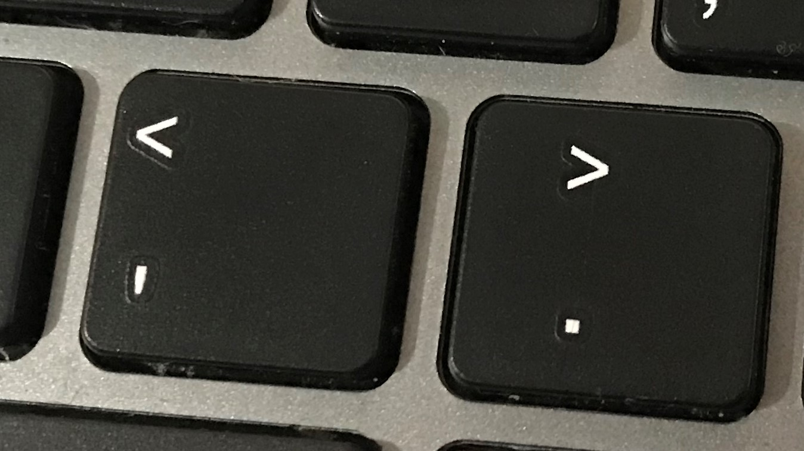
How to remember less than and more than
Less than is on the left on a typical keyboard.

Slide 7

Solve the anagrams
These are all key words that have been used so far in this unit.
TEENSLIOC
TOCODIINN
WOLF RACHT
RIVEBALA
TORNASLTRA
Explorer task
Can you write a definition for any of the words?

Slide 8
Solve the anagrams
These are all key words that have been used so far in this unit.
SELECTION
CONDITION
FLOW CHART
VARIABLE
TRANSLATOR
Explorer task
Can you write a definition for any of the words?

Slide 9
Fundamentals of Digital Services and Their Features

Slide 10

What are Digital Services?
Digital services are services that are delivered or enabled through digital technology, such as the internet, mobile phones, and other digital media.
Digital services can include anything from online banking and shopping to streaming media and social media.

Slide 11

Benefits of Digital Services
Digital services offer a number of advantages over traditional services, including:
• Increased efficiency and cost savings
• Improved customer service and satisfaction
• Increased access to information and resources
• Increased collaboration and communication

Slide 12
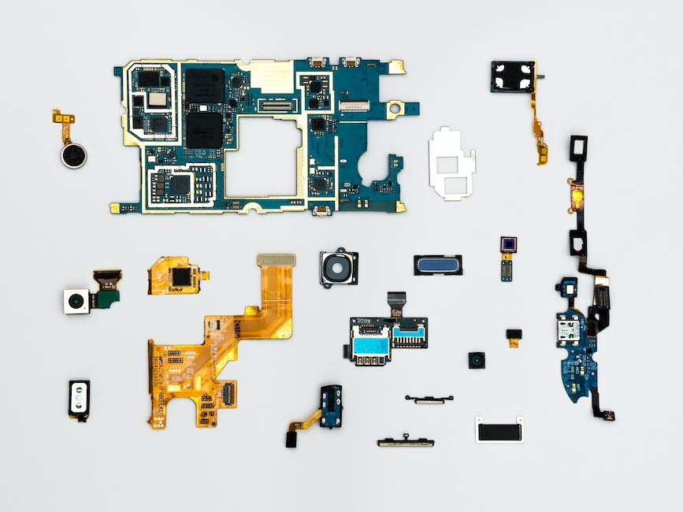
Types of Digital Services
There are a number of different types of digital services, including:
• Web-based services, such as online banking and shopping
• Mobile services, such as mobile banking and shopping
• Social media services, such as Facebook and Twitter
• Streaming media services, such as Netflix and Hulu

Slide 13

Features of Digital Services
Digital services offer a number of features, including:
• Increased convenience and accessibility
• Increased security and privacy
• Increased speed and accuracy
• Increased scalability and flexibility

Slide 14

Advantages of Digital Services
Digital services offer a number of advantages over traditional services, including:
• Increased efficiency and cost savings
• Improved customer service and satisfaction
• Increased access to information and resources
• Increased collaboration and communication

Slide 15
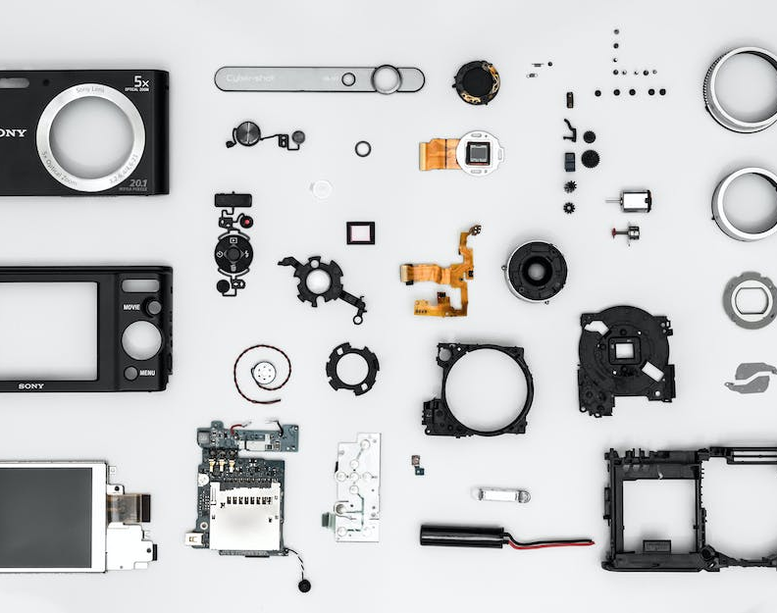
Disadvantages of Digital Services
Digital services also have some disadvantages, including:
• Increased risk of cybercrime and data breaches
• Increased reliance on technology
• Increased potential for misuse and abuse
• Increased potential for privacy violations

Slide 16

Examples of Digital Services
Some examples of digital services include:
• Online banking and shopping
• Mobile banking and shopping
• Social media services
• Streaming media services

Slide 17

Conclusion
Digital services offer a number of advantages over traditional services, including increased efficiency and cost savings, improved customer service and satisfaction, increased access to information and resources, and increased collaboration and communication.
However, digital services also have some disadvantages, including increased risk of cybercrime and data breaches, increased reliance on technology, increased potential for misuse and abuse, and increased potential for privacy violations.

Slide 18
Creating a Static Website with HTML, CSS, and JavaScript

Slide 19

What is HTML?
HTML stands for Hypertext Markup Language and is the foundation of a website.
It is used to structure the content of a website, such as text, images, and links.
HTML is written in tags, which are used to define the structure of a website.

Slide 20

What is CSS?
CSS stands for Cascading Style Sheets and is used to style the content of a website.
It is used to define the look and feel of a website, such as colors, fonts, and layout.
CSS is written in rules, which are used to define the styling of a website.

Slide 21

What is JavaScript?
JavaScript is a programming language used to add interactivity to a website.
It is used to create dynamic content, such as animations, forms, and games.
JavaScript is written in code, which is used to define the interactivity of a website.

Slide 22
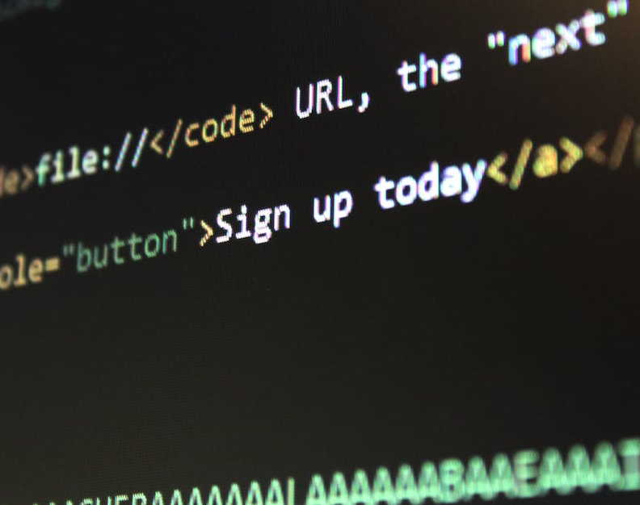
Creating a Static Website
A static website is a website that does not change or update its content.
It is created by combining HTML, CSS, and JavaScript to create a basic website.
The HTML is used to structure the content, the CSS is used to style the content, and the JavaScript is used to add interactivity to the website.

Slide 23
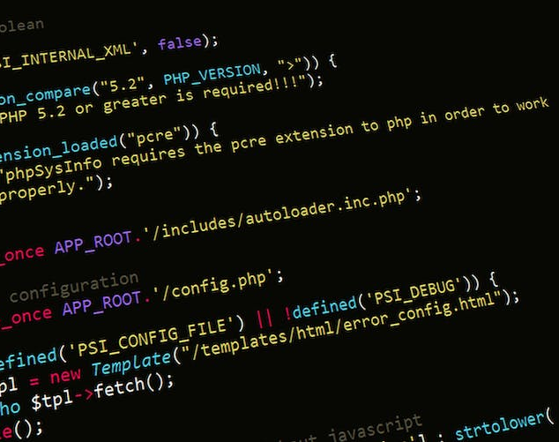
Creating a Basic Website
Creating a basic website is a great way to learn the basics of web development.
By combining HTML, CSS, and JavaScript, you can create a simple website with basic functionality.
This is a great way to learn the fundamentals of web development and get started with creating websites.

Slide 24

Learning HTML, CSS, and JavaScript
Learning HTML, CSS, and JavaScript is the first step to becoming a web developer.
These three languages are the foundation of web development and are essential for creating websites.
By learning these languages, you can create a basic website and start your journey as a web developer.

Slide 25
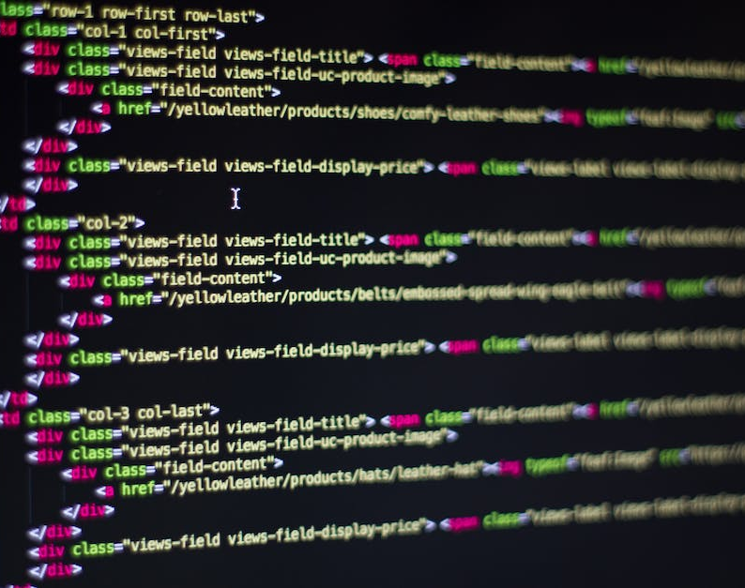
Creating a Static Website
Creating a static website is a great way to learn the basics of web development.
By combining HTML, CSS, and JavaScript, you can create a basic website with basic functionality.
This is a great way to learn the fundamentals of web development and get started with creating websites.

Slide 26

Conclusion
Creating a static website is a great way to learn the basics of web development.
By combining HTML, CSS, and JavaScript, you can create a basic website with basic functionality.
This is a great way to learn the fundamentals of web development and get started with creating websites.

Slide 27
User-Responsive Elements

Slide 28

What is User-Responsive Content?
User-responsive content is content that is tailored to the user's needs and preferences.
It is designed to be accessible to all users, regardless of their language, location, or device.

Slide 29

Why is User-Responsive Content Important?
User-responsive content is important because it ensures that all users can access and understand the content.
It also helps to create a more inclusive and diverse online experience for all users.

Slide 30

Implementing User-Responsive Elements in British English
When implementing user-responsive elements in British English, it is important to consider the language, spelling, and grammar used.
It is also important to consider the cultural context of the content, as well as the regional dialects and accents used in the UK.

Slide 31

Spelling and Grammar
When creating user-responsive content in British English, it is important to ensure that the spelling and grammar are accurate.
This includes using British English spellings, such as 'colour' instead of 'color', and using British English grammar, such as 'have got' instead of 'have'.

Slide 32

Cultural Context
When creating user-responsive content in British English, it is important to consider the cultural context of the content.
This includes understanding the cultural norms and values of the UK, as well as the regional dialects and accents used in the UK.

Slide 33

Localisation
When creating user-responsive content in British English, it is important to consider localization.
This includes adapting the content to different regions, such as Scotland, Wales, and Northern Ireland, as well as adapting the content to different dialects and accents.

Slide 34

Testing and Evaluation
When creating user-responsive content in British English, it is important to test and evaluate the content.
This includes testing the content with users from different regions and dialects, as well as evaluating the content to ensure it is accessible to all users.

Slide 35
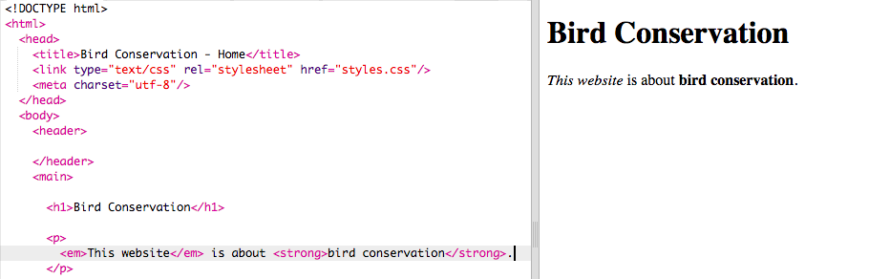
So, what is HTML?
HTML is a markup language as it defines structure.
HTML is not a programming language as it does not have features such as iteration (loops/repetition such as for and while) or branching (conditionals/decisions such as if, elif, and else).

Slide 36
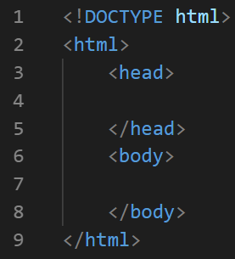
HTML essentials
There are chevrons < > around tags.
The four essential HTML features are DOCTYPE, html, head, and body. This is what we call boilerplate code as every page has it.
Most tags have a closing tag with a forward slash.

Slide 37
HTML essentials
<!DOCTYPE html> is always the first line of an HTML file.
<html> tells the browser that we have used HTML to code the page.
<head> is meant for things that aren’t displayed in the main body of your page, like the title.
<body> contains all the content you want to see displayed.

Slide 38

Browser
We can prove that all webpages have boilerplate by looking at the underlying code for one.
In a browser we can:
press CTRL+U
right-click on the page we are on and choose ‘View Source’ (IE) or ‘View Page Source’ (Chrome)
You should be able to find features from the boilerplate such as:
<!DOCTYPE>
<html>
<head>
<body>

Slide 39
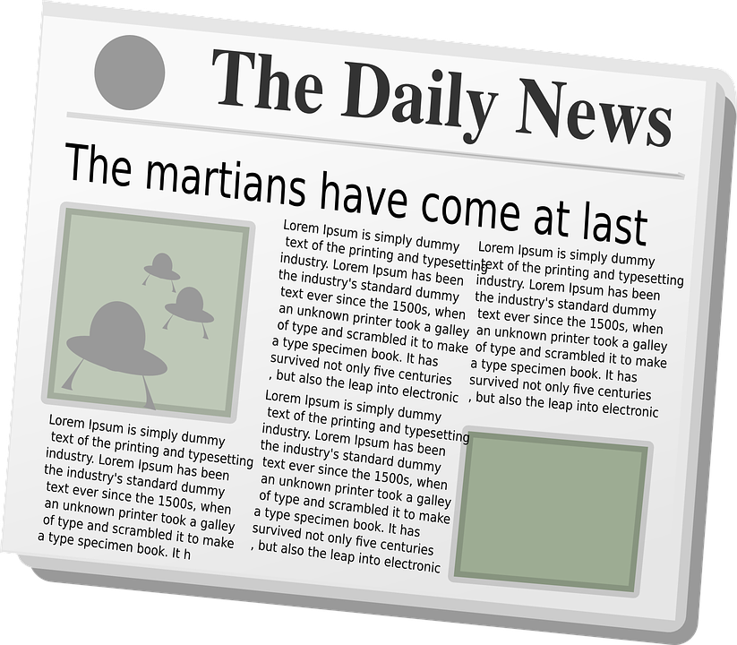
Common HTML elements
Main heading
In HTML this is given by
<h1>The Daily News</h1>
Subheading
In HTML this is given by
<h3>The Daily News</h3>
There are six different sizes of the
h tag (h1 to h6)
Paragraphs (normal text)
In HTML this is given by
<p>Some text</p>
Notes:
Image source: https://pixabay.com/vectors/newspaper-news-paper-journal-151438/

Slide 40
Task
Create a folder in your user area named ‘website’.
This is where you are going to save all of your work for this project.
Be careful to only work within this folder during the project otherwise your website may not work as intended.

Slide 41
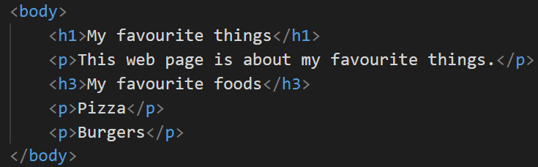
Your first webpage
What do you think this code will display, and what will it look like?
Use the code editor to see if your prediction was correct.

Slide 42
Saving and displaying your page
After you have finished writing the code, save it (CTRL+S) into the folder you created as index.html.
Then navigate to where you saved the file.
You should be able to double click on the file, or right-click on it and choose ‘Open with’ then choose Google Chrome/Safari/Edge/Firefox.

Slide 43
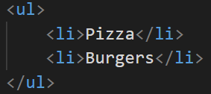
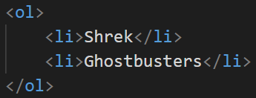
List tags
Using HTML list tags we can create two different types of lists:
<ul> stands for unordered list
<ol> stands for an ordered list
What do you think is the difference?

Slide 44


List tags

Slide 45
List tags
Can you create some lists for your page (top 10 musical artists, games, etc.)?
Explorer task: Can you create a list with different levels like this?
Item 1
Item a
Item b
Item 2
Item 3

Slide 46
Question 1
What does HTML stand for?

Slide 47
Question 1 – answer
What does HTML stand for?
HyperText Markup Language

Slide 48
Question 2
What does the tag look like for creating a heading?
How many different types of headings are there?

Slide 49
Question 2 – answer
What does the tag look like for creating a heading?
<h1> to <h6>
How many different types of headings are there?
Six: <h1> to <h6>
(biggest to smallest / most important to least important)

Slide 50
Question 3
What is the difference between the start and end tags?
What do we call this? <

Slide 51
Question 3 – answer
What is the difference between the start and end tags?
End tags have a forward slash: <h1> </h1>
What do we call this? <
A chevron

Slide 52
Question 4
Which of these comes first? <head> or <body>
What is the purpose of these sections?

Slide 53
Question 4 – answer
Which of these comes first? <head> or <body>
<head> is first, followed by <body>
What is the purpose of these sections?
<head> is meant for things that aren’t displayed in the main body of your page, like the title
<body> contains all the content you want to see displayed

Slide 54
Question 5
What does the tag look like for creating a paragraph?
When should we use paragraphs and when should we use headings?

Slide 55
Question 5 – answer
What does the tag look like for creating a paragraph?
<p> </p>
When should we use paragraphs and when should we use headings?
Headings are meant for signalling the start of a section of text so a user can skim the contents of a page. Search engines can also use headings to index the content and structure of your webpages.
Paragraphs are meant for normal text

Slide 56
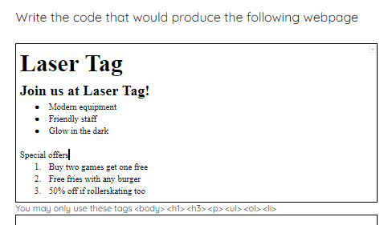
Write the HTML for a page
On the handout write the HTML for the page on the sheet using the box provided
Also: You could also try practising at home!
Notes:
HTML code – Worksheet to learners

Slide 57
Objectives
Following this session, you should be able to:
Understand the Fundamentals of Digital Services and Their Features
Master Basic HTML, CSS, and JavaScript to Create a Static Website
Implement User-responsive Elements
Describe the purpose of HTML and tags when designing a website

Slide 58

Questions?

Slide 59
Thank You

